Slide 1
Serene Landscape or Potential Minefield
Navigating the Generational Divide
Presenters: James Forkum, Ph.D.
Sherry Forkum, Ph.D.

Slide 2
California Community College
Athletics Directors Association
Summer Conference
June 4, 2019
Lake Tahoe, Nevada

Slide 3
Defining the Issues
The Entitlement Mindset
Upcoming Homelanders
LGBTQIA – Being an Ally
Strategies
Changing the Paradigm

Slide 4
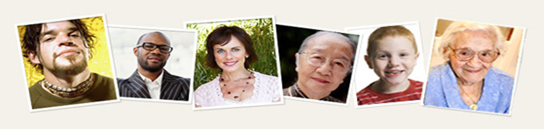
Generations
G. I. – 1901-1924 (ages 95-118)
Silent – 1925-1942 (ages 77-94)
Boomers – 1943-1960 (ages 59-76)
Generation X – 1961-1981 (ages 38-58)
Millennials – 1982-2004 (ages 15-37)
Homelander – 2005 – to present (ages 14 and under)

Slide 5
GENERATIONAL COMPARISONS
 | SILENT | BOOMER | GEN X | MILLENNIAL | HOME-LANDER
Size | 52 Million/Declining | 78 Million/Declining | 70.2 Million | 78-100 Million | Growing Slowly(30%)
Other Names | Traditionalists | Consciousness Generation Me Generation | Modern “Lost” Generation Slacker Generation | Generation Y Echo Boom Generation Next Digital Generation | Gen Z Re-Gen Anti-Gen
Heroes | GI Generation | Themselves | Anti-Heroes | Parents | Super Heroes
Family Life | Earliest marrying and babying generation Silent women divorces in record numbers Large numbers of women in the workforce later in the generational cycle | Religious and/or spiritually oriented Health oriented Waiting until later in life to have children Have become “helicopter” parents | Adult oriented from an early age “Anti-child” movement Less parental supervision than ever before Little peer interaction in childhood | “Special” – eagerly anticipated Lowest parent to child ratio ever Universally protected Sheltered “Drone” Parenting | More “Special” Planned More Protected More Security Non-Communicative Digital-Focused Barraged with Anti-Everything

Slide 6
 | SILENT | BOOMER | GEN X | MILLENNIAL | HOMELANDER
Work | Large increase in number of people in “helping professionals” in 1960s | Workaholics Career focused | First to seek work/life balance Not constrained by time and/or place | 3 out of 4 work more than 31 hours per week More discretionary income than any previous group WeWork/WeLive Environments | Unknown
Significant Life Events | Depression Sexual revolution occurred while this generation was in mid-life Korean War | Vietnam Sexual revolution Kent State | Gulf War Berlin Wall comes down Challenger explosion | Columbine September 11 Second Gulf War | Death of Bin-Laden First President of Color Recession Shrinking Middle Class War on Terror “Reality” President
*Notes | Generation of jealousies and role reversals Focused on previous generation while young and subsequent generation in adulthood | Intense attention focused on this group for the entire Boomer lifespan Self-aware and self-centered (largest number of self-help books) | Mired in an age of death *AIDS *Homicides drug-related deaths increased *Suicidal (at a near record rate of almost 5000/year in mid 1980s) | Optimistic Conventional Racially diverse Pressured | First generation of 21st Century “Tiny” Helpers Tethered within the home (Like Silents) NOT encouraged to take chances Most safety drills in schools Armed Suicides at a younger age

Slide 7
Problematic Issues
Beginning well before college
Not only bottom-up, but top-down
‘Selfie Age’, ‘Special Snowflake’ Generation
Unbalance between what the student-athlete wants and what he/she needs
A divide between learning and education

Slide 8
Problematic Issues continued…
What is experienced in college matters more to their future than happiness of earning a specific grade ever could.
Media Consumption
Active Shooter – During practice or event
All Thumbs – Manual dexterity

Slide 9
2018 Fall Student Gallup Poll 5th -12th Grades
Engagement – THE INVOLVEMENT IN AND ENTHUSIASM FOR SCHOOL –
Overall 47% were Engaged in their learning
30% Not engaged
23% Actively Disengaged
Hope - THE IDEAS AND ENERGY STUDENTS HAVE FOR THE FUTURE –
43% were Hopeful
36% Stuck
21% Discouraged

Slide 10
One View: Rhonda Rompola (SMU 1991-2016)
Changing Attitudes of Student-Athletes
Kids are not as coachable
Talking back to coaches is the norm
Concern about ‘the check’
Rule changes have made recruiting more stressful and added to the entitlement factor
Texting, shopping around
Adjusting to kids rather than kids adjusting to coaches and the programs
Are you adjusting your programs for the kids (student-athletes)?

Slide 11

Drug Use and Attitudes
What NCAA Division has the highest rate of marijuana and other drug use?
Student-Athletes, compared to other students on campus, report higher rates of heavy episodic drinking. One in five male student-athletes using alcohol report drinking 10 or more drinks in an outing.
Fewer NCAA student-athletes report using marijuana than other students on campus. The percentage has remained relatively flat over the last 10 years.
57% said testing is a deterrent for drug use
The new illicit drug-use concern is the abuse of prescription stimulants and narcotics
Alcohol is now being served at 4-year college venues
Many student-athletes are not comfortable in their athlete social circles. Many feel entitled to more flexibility and preferential treatment from professors.
Many student-athletes feel stereotyped by their professors and the community

Slide 12
Myth and Reality
A number of student-athletes believe campus life is about partying, alcohol abuse and drug use.
Two most reported recreational drugs on campus are alcohol and marijuana, but student-athletes are using less than other students.
30% report experiencing blackouts.
Prevention is the science to curb the use.
The CDC’s model of social-ecological framework shows for student-athletes this translates into team, department, and campus as a whole.
Athletics administrators have found greater success when they partner with the campus prevention specialists.

Slide 13

In the classroom
All students would take the easy out, if offered
Only A’s count, not the B’s and below
School is viewed as unrelated to the future. Think entrepreneurs
Student-Athletes are in the Pro-or-Nothing thought (Hover-parenting is part of the issue). Bring this attitude into the classroom.

Slide 14
Inclusion and being up-to-date
LGBTQIA (Lesbian, Gay, Bisexual, Transgender, Queer, Intersex, Asexual) Resource Center
Caster Semenya – Naturally elevated levels of the muscle-building hormone testosterone
What will be the CCCADA stance and policies on gender fluidity?

Slide 15
Transgender and Non-binary Inclusion
Transgender or trans – sometimes used as an umbrella term – may identify as straight, gay, lesbian, or bisexual
Sex assigned at birth – sex assigned often based on physical anatomy and/or chromosomal makeup
A Male-to-Female (MTF)
A Female-to-Male (FTM)
Non-Binary (also nonbinary) – umbrella term for all genders other than female/male or woman/man, used as an adjective. Not all nonbinary people identify as transgender and not all transgender people identify as nonbinary.

Slide 16

Insights and Ideas
Pat Riley said it best about student-athlete entitlement referring to “the disease of me”.
Does your program and do your coaches actively reinforce and build a culture of student-athlete accountability?
Paradigm shift to offering career options particularly for the struggling student-athlete
According to Dr. Gilbert –
1. Do you use messages to clarify the concept?
2. Practice team activities to develop and recognize desired behaviors?
3. Model the message and the behaviors to reinforce accountability?

Slide 17
Examples…
“Play for the name on the front of your jersey, not the one on the back.” Herb Brooks
“We win together, we lose together, and we refuse to point fingers at one another.” Mike Metheny
“Never make the same mistake twice, because the second time you make it it’s not a mistake, it’s a choice.” Pat Fitzgerald
“Focus on being the best player for the team instead of the best player on the team.” Bo Hanson
Learn the difference between selfless and selfish.

Slide 18

Building a Durable Culture
Provide student-athlete accountability
“Hard-Hat” Award
Bronco Mendenhall – “Everything Earned, Nothing Given”
Model the Message: Every Single Day
Lead by Example
Provide Team Activities and Rituals – Accountability and Desired Behaviors

Slide 19
Changing the Paradigm
Vocational Certificate Approach
Counseling New Hires
Conscious Efforts To Model Behavior In Regard To Sense of Entitlement
Renewed Emphasis on Core Values
Intern Programs
Valuing Age

Slide 20
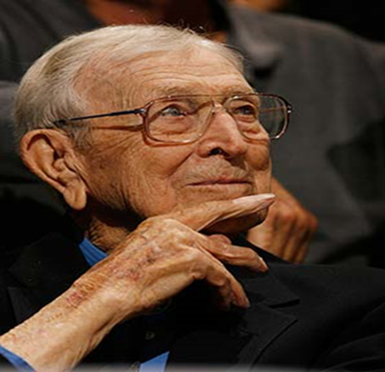
In Closing…
“I’m no wizard. I am a teacher.” John Wooden said he learned to coach by applying what he learned as a high school English teacher. Coach believed the principles of teaching are the same for classrooms and courts. Teaching academics or athletics, he insisted, is more effective if these fundamentals are followed. Coach often quoted this poem:
“No written word, no spoken plea can teach our youth what they should be. Not all the books on all the shelves but what the teachers are themselves.” – Rudyard Kipling

Slide 21
Questions, Discussions, Comments
We thank you for your time and kind attention!
Contact information: 916.390.5574
js4kum@comcast.net

Slide 22
Presenters' Research
Resources listed on Reference Page
Presenters' personal research from university/college, 2 yr. college, and high school environments
Athletics Administration, Coaching Experiences, Class/Courseroom Interactions and Observations

Slide 23
References
AP News. (2016). http://www.si.com/womens-college-basketball/2016/02/25/ap-bks-smu-rompola
Berg, T. (2014). http://ftw.usatoday.com/2014/02/st-louis-cardinals-manager-cleans-clubhouse-toilets
Gallimore, J. (2016). What John Wooden can teach us. http://www.edweek.org/ew/articles/2006/03/01/25gallimore.h25.html.
Gallup.com. (2019)
Gilbert, Wade. 2016. Busting a culture of athlete entitlement.
Gordon, J. (2015). The hard hat: 21 ways to be a great teammate. Wiley.
Grassgreen, Allie. 2014. Drug use and attitudes about entitlement among athletes. https://www.insidehighered.com.
Hanson, B. (2015). Being the best athlete for the team: 5 minutes with Bo Hanson. http://www.athleteassessments.com/being-the-best-athlete-for-the-team-5-minutes-with-bo-hanson/.
Metheny, M., & Jenkins, J. B. (2015). The Mathey manifesto: A young manager’s old-school view on success in sport and life. Random house.
NCAA Convention 2014 – San Diego
New York Times. (2016) – Your Surgeon’s Childhood Hobbies May Affect Your Health.
Positive Coaching Alliance. (2016). Stephen Bardo: Coaching in the “Selfie Age”. http://devzone.positivecoach.org/resource/video/Stephen-bardo-coaching-selfie-age.
Ramirez-Perez, D. (2019). A Food Pyramid For Kids’ Media Consumption. Wired.
Ramspacher, A. (2016). Mendenhall’s ‘Hoos will have to earn their jersey numbers. http://www.dailyprogress.com/cavalierinsider/mendenhall-s-hoos-will-have-to-earn-their-jersey-numberbs/article.
Riley, P. (1994). The winner within: A life plan for team players. Berkley.
UCDavis. LGBTQIA. lgbtqia.ucdavis.edu
Vasko, B. (2016). Can you coach character? http://mycoachbook.com/index.php/videos/6223/1480/can-you-coach-character#.
Warner, J. (2016). Students Aren’t Coddled. They’re Defeated. https://www.insidehighered.com
Young, J. (2014). Coaches are role models: Tales of influence. Coaching and Sport Science Review, 64(22), 21-22.

