Slide 1
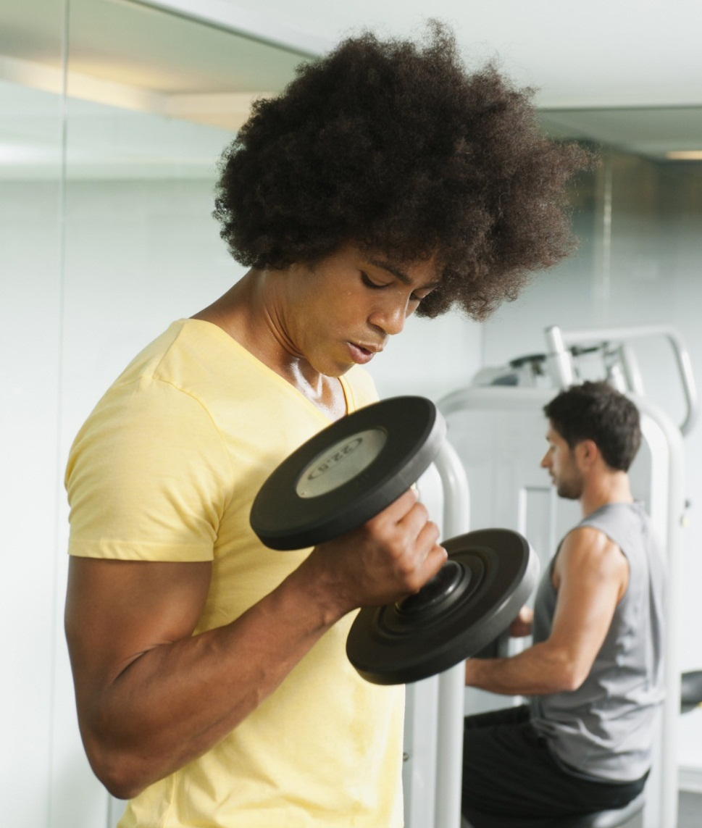


Athletic View – Student Centered funding Model
California Community College Athletic Association
Spring Conference
March 27, 2019

Slide 2
Tim McGrath
Golden West College President
CCCAA Board Member
Chair of the CCCAA Academic and Athletic Standards Review Committee

Slide 3
Student success Funding Formula

Slide 4
How community Colleges are funded
FTES: Full-time equivalent students
It is a measure of the total contact hours by all students at an institution
525 contact hours equals 1 FTES
1 student, attending 15 hours per week, for two semesters of 17.5 weeks = 525 hours
For example, a standard semester-length course that meets three per week (3 hours per week) for 17.5 weeks with 35 students at census would be 3.5 FTES
  35 students X 3 hours per week X 17.5 weeks = 1,837.5/525=3.5 FTES
  Previous Funding Model 3.5 x $5,547 = $19,414.5
  Student Success Funding Formula 3.5 x $3,727 = $13,044.5

Slide 5
Budget – New Funding Model
FTES:
  FTES:
  Credit
  Traditional College Class $3,727
  Special Admit $5,457
  High School Dual Enrollment
  Incarcerated Credit $5,457
  Prison College Programs
  Enhanced Non-Credit $5,457
  (English/Math/ESL)
  Non-Credit $3,347
  (All Other Non-Credit)

Slide 6
Old Funding Model vs. Student Centered Funding Formula for golden west college
Funding Formula FTES Base Allocation
Previous Funding Formula 9,500 $51,841,500
($5,457 per FTES)
Student Centered Funding Formula 9,500 $35,406,500
($3,727 per FTES)
Difference ($16,435,000)

Slide 7
New Student success Funding Formula and opportunities for athletics

Slide 8
Economic impact of athletics
Direct
    450 to 500 student/athletes taking an average of 14 units each semester (1.17 FTES per athlete per year @ $3,727 per FTES)
    Translates to minimum of $1.67 to 1.86 million annually
Indirect
    Athletes bring friends & family to campus – which significantly increase the enrollment influence of the athletic program
    Positive press coverage on a weekly basis
    Identifiable connection with community/county
    One of the few areas where alumni connect with a community college resulting in life-long relationships with the institution

Slide 9
Student Success Allocation
Component | Base | Promise | Pell | Total Amount if all 3 Categories are met
Associate Degrees | $1,320 | $ 333 | $ 500 | $2,153
Baccalaureate Degrees | $1,320 | $ 333 | $ 500 | $2,153
Associate Degrees of Transfer (ADT’s) | $1,760 | $ 444 | $ 666 | $2,870
Credit Certificates | $ 880 | $ 222 | $ 333 | $1,435
Completion of 9 or more CTE units | $ 440 | $ 111 | $ 167 | $ 718
Transfer to a 4 year university | $ 660 | $ 167 | $ 250 | $1,077
Completion of transfer-level Math and English 1st year | $ 880 | $ 222 | $ 333 | $1,435
Attainment – regional living wage | $ 440 | $ 111 | $ 167 | $ 718

Slide 10
Commitment of an athlete
State guidelines for athletes
  Maintain 12 units each semester
  9 of the 12 units must count towards transfer/associate degree/certification
  Four semester education plan; Counselor approved
  Maintain 2.0 GPA
  Successfully complete 24 units to participate in 2nd year of competition
  Weekly schedule for an athlete
  Minimum of 12 hours in class
  10 hours of practice
  18 hours for homework
  (Based on two hours of homework for each lecture hour of class)

Slide 11
Benefits of Athletics
In 2017-18 GWC had 302 student-athletes on the form 3s and another 72 identified as redshirt/grey shirt = 374
In 2018-19 GWC had 306 student-athletes on the form 3s and another 80 identified as redshirt/grey shirt = 386
2017-18 (All Data below taken from CalPass)
Average units attempted from a Student Athlete for 2017/18 was 30.02 units
Average units attempted from GWC Student for 2017/18 was 11.89 units
If you compare FT Student Athletes with FT GWC College students
Average unit attempted from a FT Student Athlete 34.54
Average units attempted from GWC Full-Time Student 29.30
GWC student-athletes in 2017/18 made up of roughly 10% of the full time student body at Golden West.

Slide 12
Golden West College – Athletics vs/ General Population
2018-2019 | GWC Student Athletes |  | General GWC Student Population
Term Enrolled | Count of Students | Avg Units Enrolled | Count of Students | Avg Units Enrolled
Fall 2018 | 366 | 13 | 11,629 | 8
Spring 2019 | 336 | 14 | 11,519 | 8

Slide 13
FTES Advantages of Athletics
 | GWC Student Athletes |  |  | GWC General Students
Term Enrolled | Number of Athletes | Average Units Enrolled | Total Athletic FTES | Number of Students | Average Units Enrolled | Total General Student FTES
Fall 2018 | 366 | 13 | 159/366 = .43 FTES per athlete | 11,629 | 8 | 3,101/11,629 = .27 FTES per General Student
Spring 2019 | 336 | 14 | 157/336 = .47 FTES per athlete | 11,519 | 8 | 3,071/11,519 = .27 FTES per General Student
Total |  |  | .90 FTES per Athlete |  |  | .54 FTES Per General Student

Slide 14
New Funding Formula and Athletics
First year
Base FTES = $3,727
Students who get through Math and English ($880) + Promise ($222) + Pell ($333) = $1,435
Total First Year = $5,162
Second year
Base FTES = $3,727
Students who graduate with AA Degree ($1,320) + Promise ($333) + Pell ($500) = $2,153
Students who transfer to 4 year university Base ($660) + Promise ($167) + Pell ($250) = $1,077
Total Second Year = $6,957
Total for two years: $12,119
Average = $6,060

Slide 15
Enrollment management and Athletics

Slide 16
Basketball/men’s and women
Based on a total of 25 players combined on Men’s and Women’s teams
Assumptions
.90 FTES (Average FTES per GWC Athlete)
New Base FTES rate = $3,727
$3,727 * .90 = $3,354
Base FTES = $3,354 per athlete

Slide 17
First Year
Based on a total of 25 players combined on Men’s and Women’s teams
Base FTES = $3,354
First Year
Students who get through Math and English ($880) + Promise ($222) + Pell ($333) = $1,435
Total First Year = $4,789 FTES under new SSFF
$4,789 * 25 = $119,725
Total First Year Basketball FTES = $119,725

Slide 18
Second Year
Based on a total of 25 players combined on Men’s and Women’s teams
Second year
Base FTES = $3,354
Students who graduate with AA Degree ($1,320) + Promise ($333) + Pell ($500) = $2,153
Students who transfer to 4 year university Base ($660) + Promise ($167) + Pell ($250) = $1,077
Total Second Year = $6,584 under new SSFF
$6,584 * 25 = $164,600
Total Second Year Basketball FTES = $164,600

Slide 19
Total FTES for GWC Men’s and women’s basketball teams for two years
Total First Year Basketball FTES = $119,725
Total Second Year Basketball FTES = $164,600
Total Two Years = $284,325

Slide 20
Enrollment management and athletics
Basketball Start Up Costs
 | Shot Clocks - Backboard replacement | $12,363.17
 | - Install Costs | $6,795.00
 | Scores Table | $3,500.00
 | Gym Floor (2 options)
 | - Sand and restripe (really needs to be done) | $28,500.00
 | Storage Racks for Uniforms in Equipment Room | $1,600.00
 | Basketballs (Men's and Women's) | $3,500.00
 | Ball Storage | $600.00
 | Additional Equipment | $1,500.00
 | Women's Uniforms | $10,738.60
 | Men's Uniforms | $10,910.77
 | Cost to Startup Basketball | $80,007.54

Slide 21
Basketball Ongoing costs
Basketball Ongoing Costs
 | Basketballs (Men's and Women's) | $1,800.00
 | Women's Uniforms |  | $5,000.00 | (Put on uniform replacement cycle)
 | Men's Uniforms |  | $5,000.00 | (Put on uniform replacement cycle)
 | Additional Soap for laundry | $500.00
 | Event Staff - (Table Workers) | $1,850.00
 | Athletic EQ overtime - (Holiday Time) | $6,000.00
 | Athletic Trainer to Cover Hours - (Holiday Time) | $8,000.00
 | Men's Budget Increase (from GF) | $4,000.00 |  | *Includes Video Agreement
 | Women's Budget Increase (from GF) | $4,000.00 |  | *Includes Video Agreement
 | Mirror OCC's LHE Allocation
 | - Men's Basketball
 | - Head Coach 14.4 LHE for (summer/Fall/Spring)
 | - 1 Assistant Coach 11.3 for (Fall/Spring)
 | - Women's Basketball
 | - Head Coach 14.4 LHE for (summer/Fall/Spring)
 | - 1 Assistant Coach 11.3 for (Fall/Spring)
 | Referee Costs
 | - Men's Games (Avg 9 home games) | $3,780.00
 | - Women's Games (Avg 9 home games) | $3,780.00
 | Increase Playoff's Budget from 40k to 50k | $10,000.00
 | Stat Coverage of Home Contest | $2,200.00
 | - No SID, High Priority
 | Ongoing Yearly Expenses | $45,910.00

Slide 22
Cost vs FTES Return
Basketball FTES
Total First Year Basketball FTES = $119,725
Total Second Year Basketball FTES = $164,600
Total Two Years = $284,325
Basketball Cost
Cost to start program $ 80,000
Annual Costs for program for 1st year $ 46,000
Annual Costs for program for 2nd year $ 46,000
Total two year costs $172,000
Difference $112,325

Slide 23
Athletics and new student success funding FORMULA
UNDER THE NEW STUDENTS SUCCESS FUNDING FORMULA, CAN A COLLEGE AFFORD NOT TO FUND ATHLETICS????

Slide 24
QUESTIONS AND ANSWERS AND THOUGHTS

